Slide 1
Gleissberg Cycle Dependence of Inner Zone Proton Flux
Emily J. Bregou^{1, 2}, Mary K. Hudson^{1, 3}, Brian T. Kress⁴, Murong Qin⁵, and Richard S. Selesnick⁶
¹ NCAR High Altitude Observatory, Boulder, CO, USA
² Dept. of Physics and Astronomy, University of Pennsylvania, Philadelphia, PA, USA
³ Physics and Astronomy Dept., Dartmouth College, Hanover, NH, USA
⁴ Center for Cooperative Research in the Environmental Sciences at CU Boulder, Boulder, CO, USA
⁵ Center for Space Physics, Boston University, Boston, MA, USA
⁶ Space Vehicles Directorate, Air Force Research Laboratory, Kirtland AFB, NM, USA

Slide 2
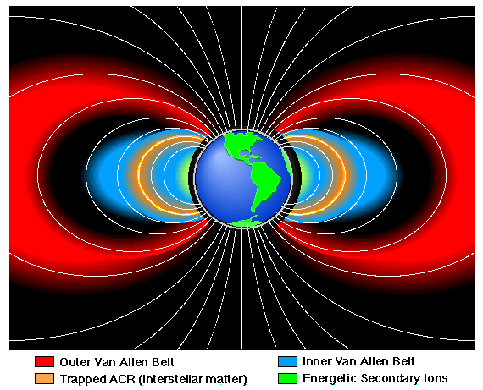
Trapped Multi-MeV protons confined to inner zone
SEP access to ligh lattitude
ρ_{i} ~ B/grad B
determines
trapping boundary
CRAND = Cosmic Ray
Albedo Neutron Decay
Source vs. Atmospheric Loss

Slide 3
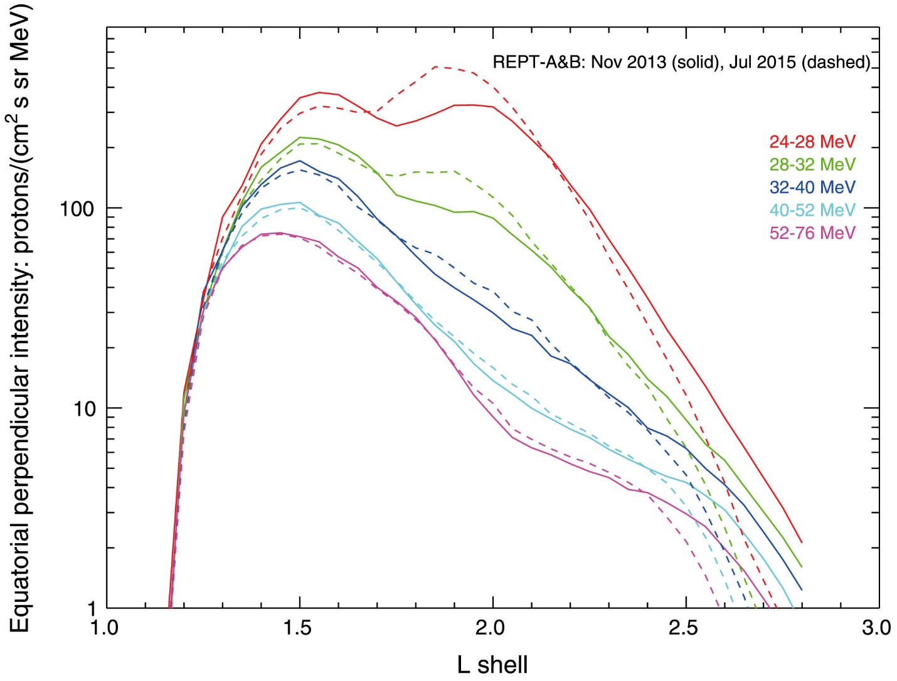
Van Allen Probes Measurements from REPT
Inner Zone Protons
Trapped SEP protons
CRAND protons
Selesnick et al., JGR, 2016
Orbit reference

Slide 4
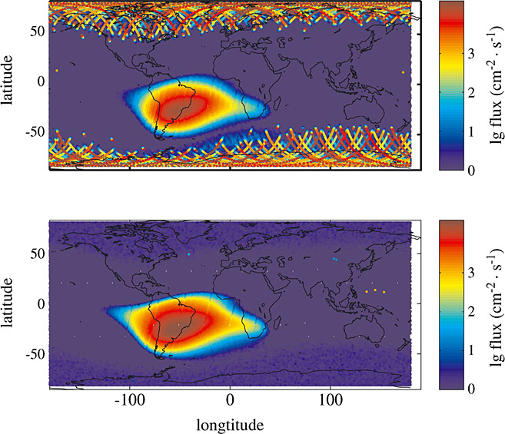
NOAA POES low
altitude polar orbiter
at ~ 850 km alt
Two examples showing (top) distribution of SAA proton fluxes during
solar proton event in Nov 2001; (bottom) distribution of SAA proton
fluxes during a geomagnetically quiet period in Nov 2009. (Qin et al., JGR, 2014)

Slide 5
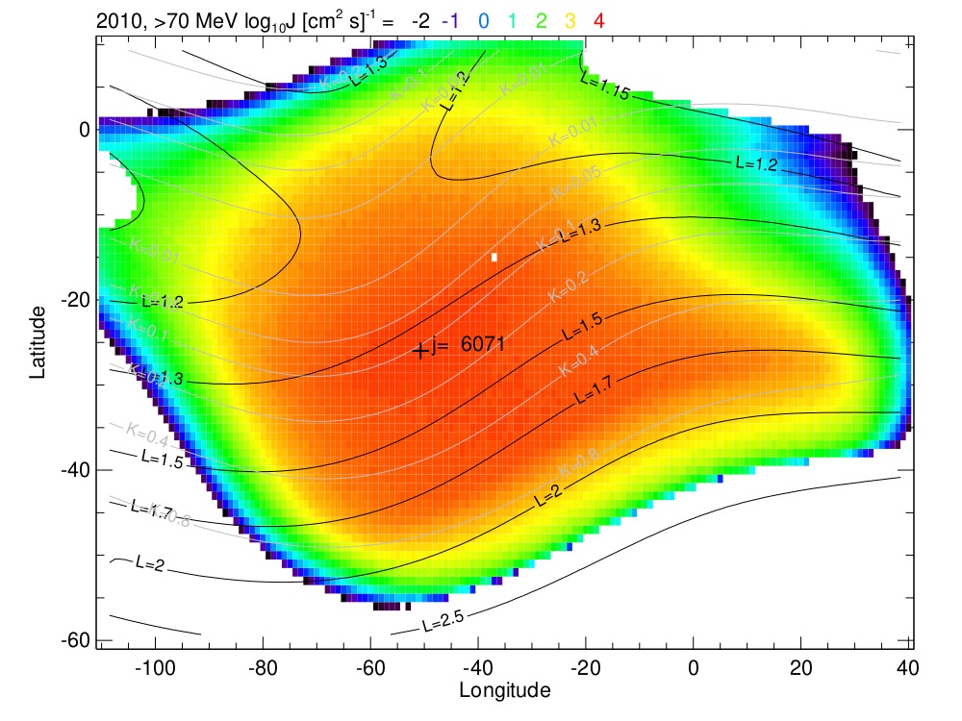
Peak POES flux at 816 km (> 70 MeV) ~ L = 1.3 (from model)

Slide 6
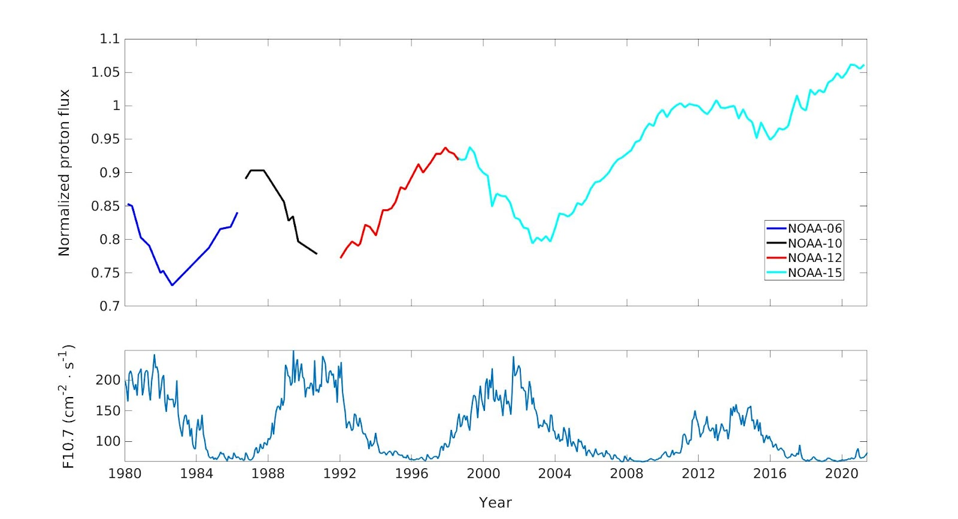
Normalized Peak Proton Flux at > 70 MeV from NOAA POES (MEPED Instrument)
Note solar cycle variation, flux max anticorrelated, peaks after solar minimum
24% increase over 42 years
Normalized to 1, 1 Jan 2009
compare Qin et al., 2014

Slide 7
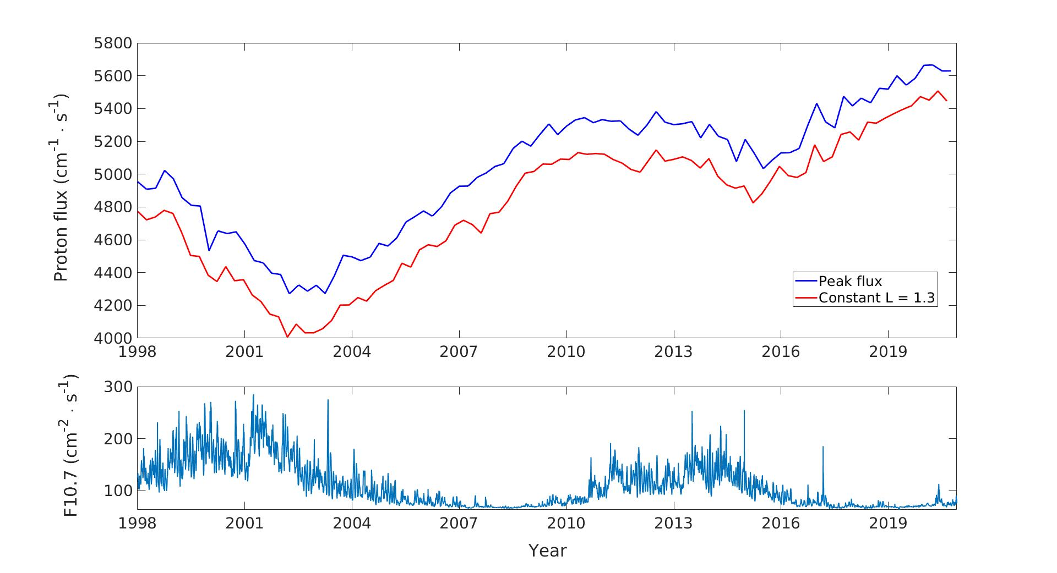
Compares Peak Flux > 70 MeV with Flux at L = 1.3
POES 15 only
Flux min lags F10.7 max

Slide 8
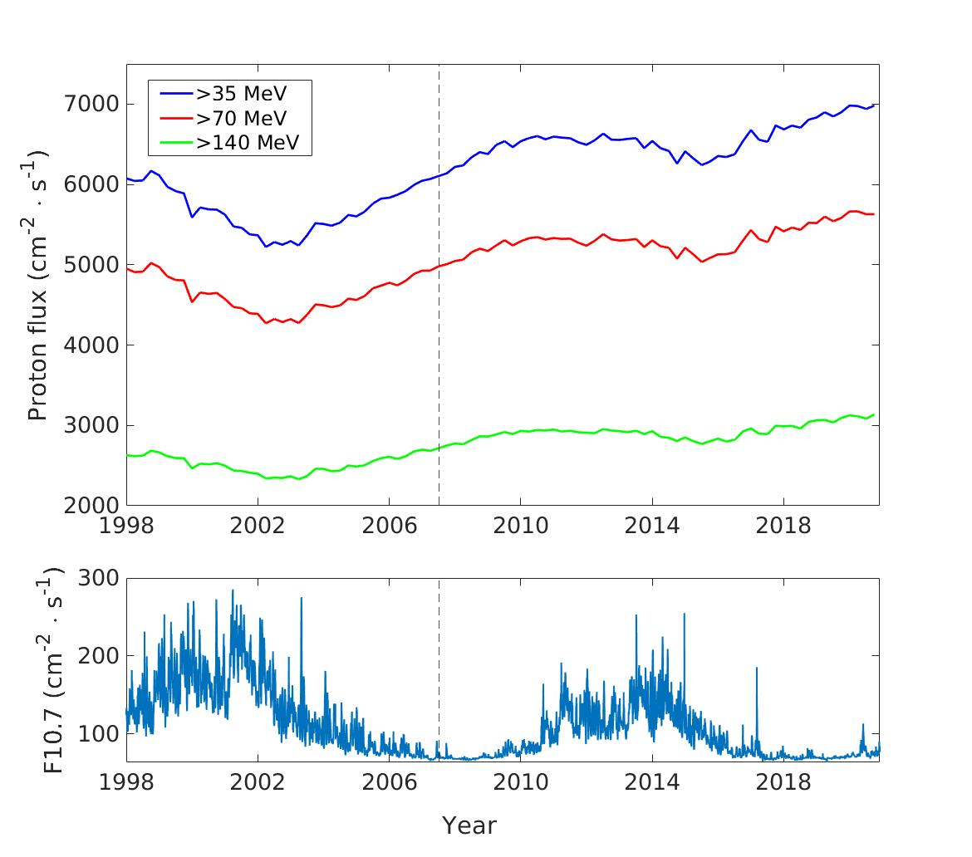
Both solar cycle phase lag in proton flux min
and long-term increase in flux are energy independent

Slide 9
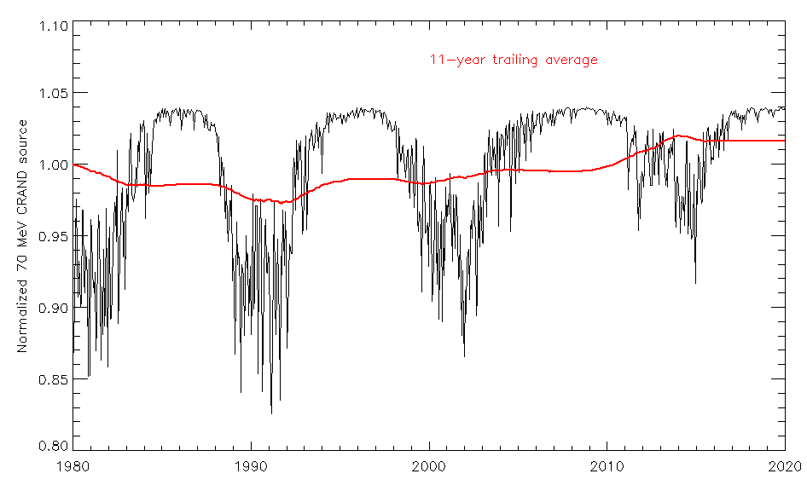
What is cause of long-term flux increase and solar cycle variation?
Not variation in GCR source, only 4% increase at L = 1.3:
Instead variation in solar EUV (F10.7 proxy) → loss
24% average increase since 1980
At the low (~850 km) POES altitude, model proton flux results from a balance between CRAND source
and energy loss caused by atmospheric drag. Atmosphere expands at solar max & drag increases (dE/dt).
Less atmosphere expansion due to weaker EUV over 40 yrs → average inner zone proton flux increase

Slide 10
Selesnick et al., Space Weather, 2007* model run for 1980 – 2022 and compared with POES > 70 MeV protons
Model Includes
CRAND proton source, atmospheric and plasmapheric drag
causing proton energy loss;
Stochastic implementation of radial diffusion, and model
geomagnetic field (IGRF) including secular variation.
NRL model atmosphere, ionosphere, and GCR spectra are
each parameterized by F10.7, used for the variable CRAND
source and energy loss rates based on proton drift-shell
averaging as a function of the three adiabatic invariants of
trapped particle motion.
Good agreement between model and measured
POES flux given req geometric factor calculation
assuming isotropic pitch angle distribution
not measured by POES
*See also Selesnick and Albert, JGR, 2019

Slide 11
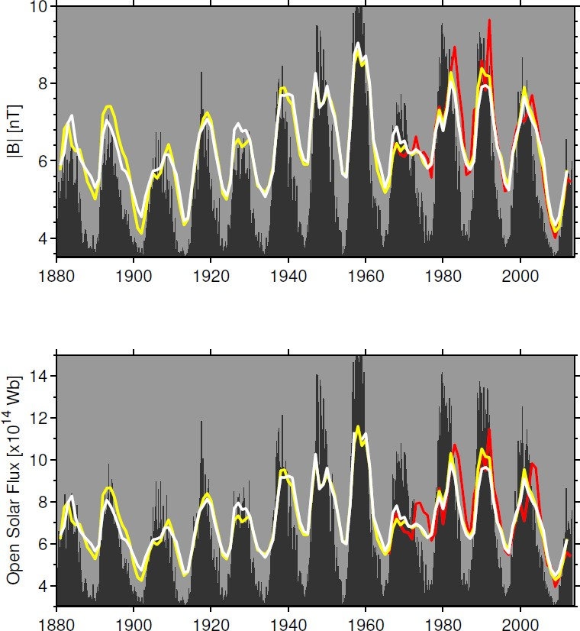
Gleissberg Cycle 80 – 100 yr period oscillation in
sunspot number (Gleissberg, 1944) seen in
solar B field at 1 AU (measured – red and
reconstructed yellow and white (Lockwood et al.,
2013; Svalgaard and Cliver, 2010).

Slide 12
Summary
The long-term NOAA POES data set allows us to investigate the Gleissberg cycle variation of inner belt protons (Gleissberg, 1944; Svalgaard et al., 2005; Feynman & Ruzmaikin, 2011, Pulkinnen et al., 2001). Feynman & Ruzmaikin (2011) described the Centennial Gleissberg Cycle as an approximately century-long sinusoidal variation in the intensity of solar maximum well established in sunspot number, finding evidence to suggest that Solar Cycles 23 and 24 represent a minimum of this 80 to 100-year cycle, also seen in other parameters such as solar polar magnetic field, which follows the higher activity level of the early space age going back to the 1960 solar maximum. Several studies predict a weak solar maximum for Solar Cycle 25 (c.f. Upton and Hathaway, 2018) suggesting continued trend.
From a space weather hazard standpoint, this long-term increase in the flux of inner zone protons should be included in updated models of the space radiation environment.

Slide 13
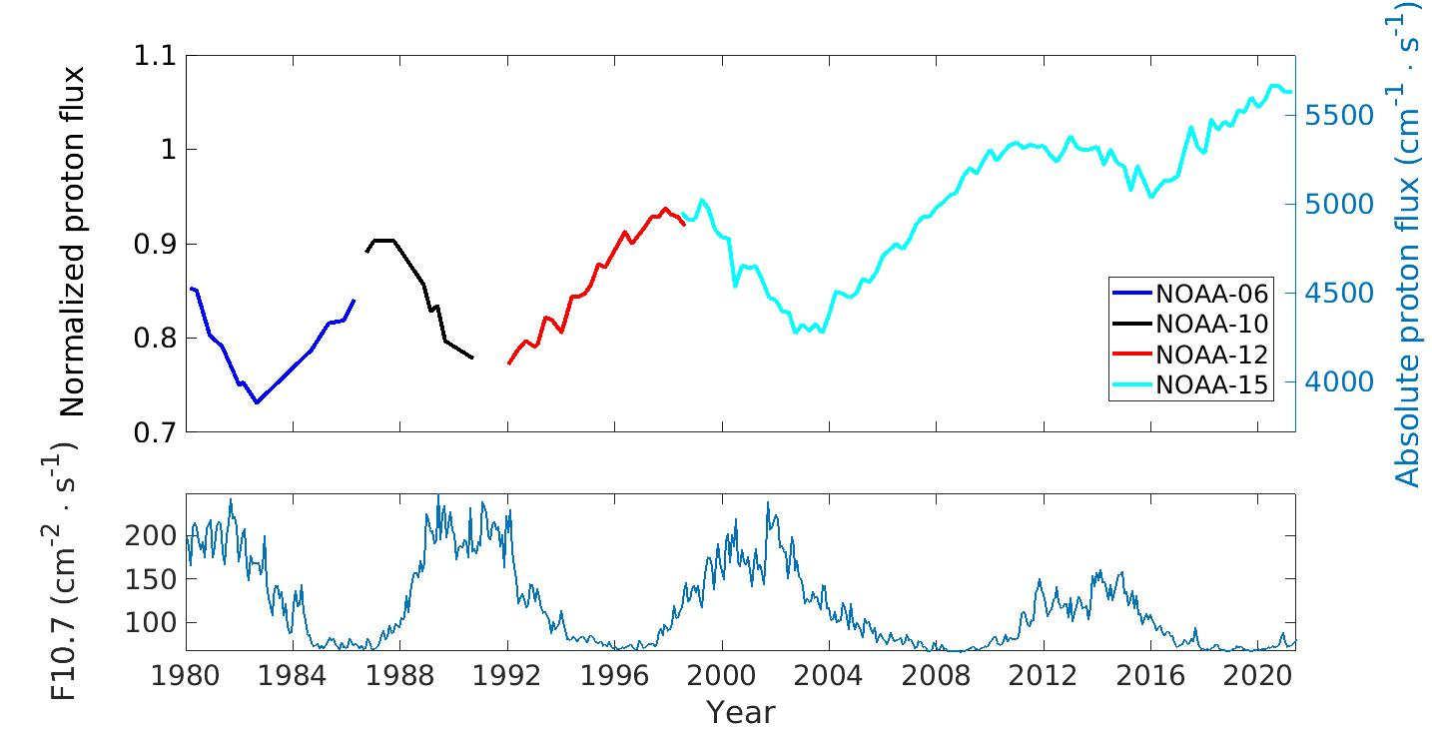
Normalized Peak Proton Flux at > 70 MeV from NOAA POES (MEPED Instrument)
Note solar cycle variation, flux max anticorrelated, peaks after solar minimum
24% increase over 42 years

Slide 14
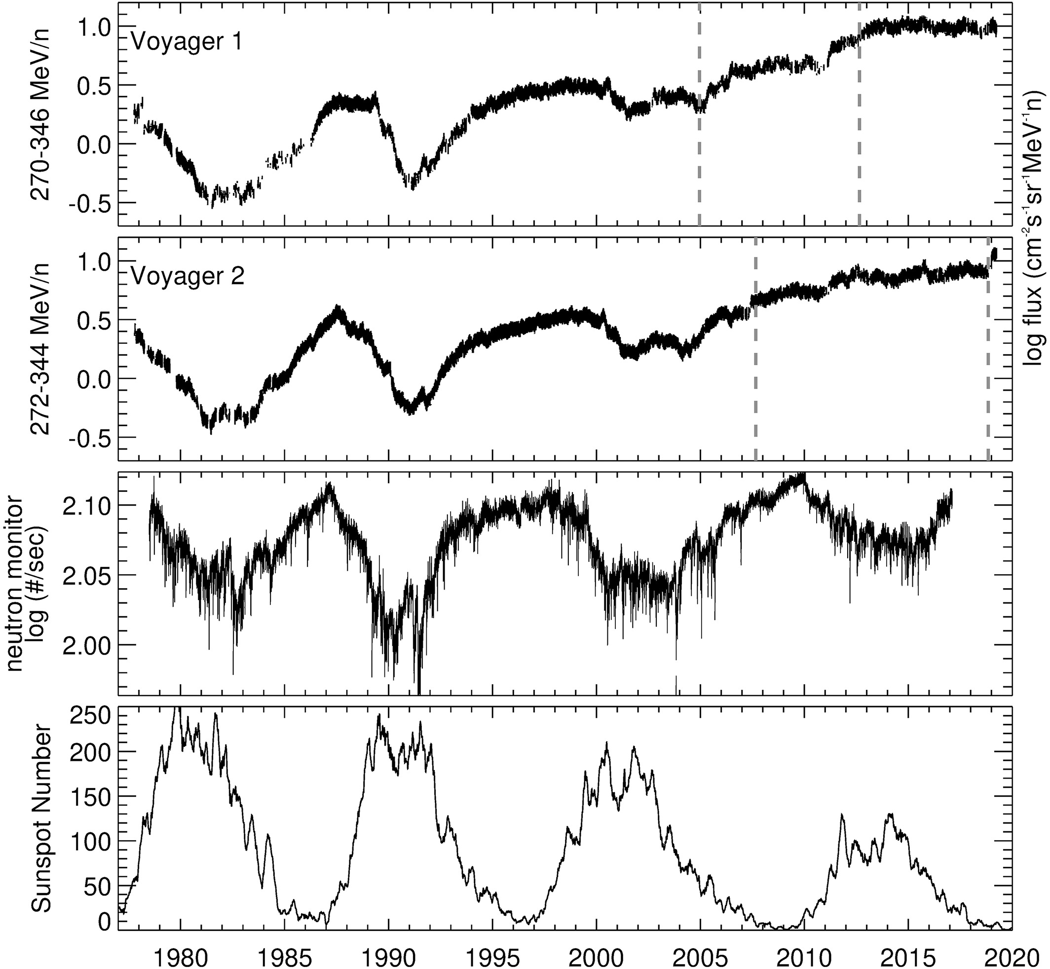
Panel 3: Increase in ground neutron monitor flux 1% at L = 1.3 (Li et al., 2020)

Slide 15
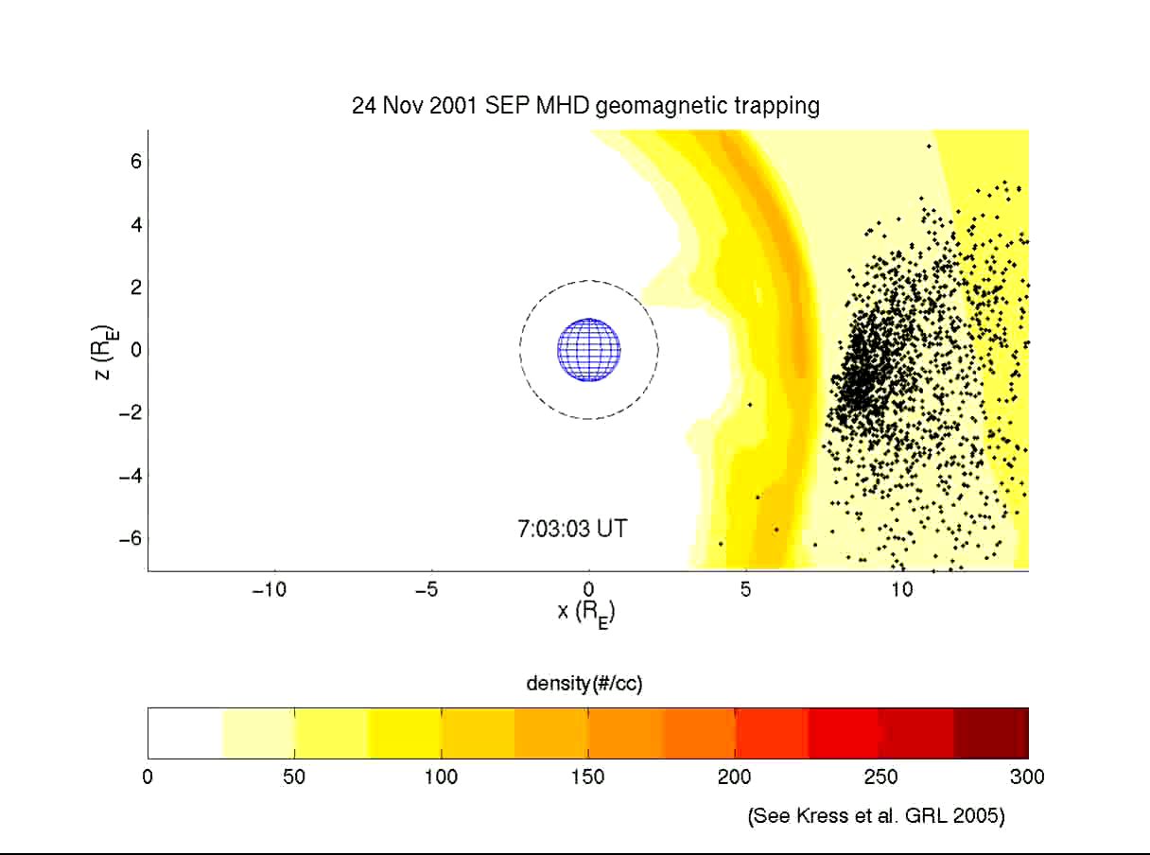
Also studying SEP trapping:
25 MeV Proton Access & Trapping

